Slide 1

Data Mining
CS-772
Department of Computer Sciences

Slide 2
Classification
Decision Tree Induction

Slide 3
Reasoning Types
The automatic generation of decision rules from examples is known as rule induction or automatic rule induction.
Generating decision rules in the implicit form of a decision tree is also often called rule induction, but the terms tree induction or decision tree induction are sometimes preferred.
Different types of reasoning
Deduction
Abduction
Induction

Slide 4
Deduction
The conclusion is shown to follow necessarily from the truth of the premises, for example
All Men Are Mortal
John is a Man
➔Therefore John is Mortal
If the first two statements (the premises) are true, then the conclusion must be true.
This type of reasoning is entirely reliable but in practice rules that are 100% certain (such as ‘all men are mortal’) are often not available.

Slide 5
Abduction
All Dogs Chase Cats
Fido Chases Cats
➔Therefore Fido is a Dog
Here the conclusion is consistent with the truth of the premises, but it may not necessarily be correct.
Fido may be some other type of animal that chases cats, or perhaps not an animal at all.
Reasoning of this kind is often very successful in practice but can sometimes lead to incorrect conclusions.

Slide 6
Induction
This is a process of generalisation based on repeated observations.
After many observations of x and y occurring together, learn the rule if x then y
For example, if I see 1,000 dogs with four legs I might reasonably conclude
that “if x is a dog then x has 4 legs” (or more simply “all dogs have four legs”).
This is induction.
The decision trees derived from the golf and degrees datasets are of this kind.
They are generalised from repeated observations (the instances in the training sets) and we would expect them to be good enough to use for predicting the classification of unseen instances in most cases, but they may not be trustworthy.

Slide 7
TDIDT algorithm is guaranteed to terminate and to give a decision tree that correctly corresponds to the data, provided that the adequacy condition is satisfied.
QUIZ
What is the adequacy condition on the instances in a training set?
What happens if the basic TDIDT algorithm is applied to a dataset for which the adequacy condition does not apply?

Slide 8
Attribute Selection
Adequacy condition is that no two instances with identical attribute values have different classifications.
However, it was also pointed out that the TDIDT algorithm is underspecified.
Provided that the adequacy condition is satisfied, any method of choosing attributes will produce a decision tree.

Slide 9
Attribute Selection Strategies
Lets consider …
takefirst – for each branch take the attributes in the order in which they appear in the training set, working from left to right, e.g. for the degrees training set in the order SoftEng, ARIN, HCI, CSA and Project.
takelast – as for takefirst, but working from right to left, e.g. for the degrees training set in the order Project, CSA, HCI, ARIN and SoftEng.
random – make a random selection (with equal probability of each attribute being selected).
+No attribute may be selected twice in the same branch

Slide 10
Vote Data Set
1984 United States Congressional Voting Records Database
Number of Instances: 435 (267 democrats, 168 republicans)
Number of Attributes: 16 + class name = 17 (all Boolean valued)
Attribute Information:
1. Class Name: 2 (democrat, republican)
2. handicapped-infants: 2 (y,n)
3. water-project-cost-sharing: 2 (y,n)
4. adoption-of-the-budget-resolution: 2 (y,n)
5. physician-fee-freeze: 2 (y,n)
6. el-salvador-aid: 2 (y,n)
7. religious-groups-in-schools: 2 (y,n)
8. anti-satellite-test-ban: 2 (y,n)
9. aid-to-nicaraguan-contras: 2 (y,n)
10. mx-missile: 2 (y,n)
11. immigration: 2 (y,n)
12. synfuels-corporation-cutback: 2 (y,n)
13. education-spending: 2 (y,n)
14. superfund-right-to-sue: 2 (y,n)
15. crime: 2 (y,n)
16. duty-free-exports: 2 (y,n)
17. export-administration-act-south-africa: 2 (y,n)
Missing Attribute Values: Denoted by "?"

Slide 11
Number of branches generated by TDIDT
Dataset Vote
take take random most least first last 1 2 3 4 5
40 79 96 78 116 110 96 116 40

Slide 12
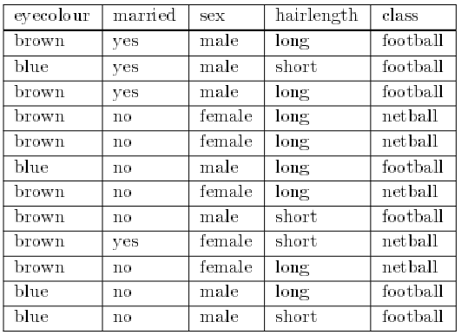
A fictitious university requires its students to enrol in one of its sports clubs, either the Football Club or the Netball Club. It is forbidden to join both clubs. Any student joining no club at all will be awarded an automatic failure in their degree (this being considered an important disciplinary offence).

Slide 13
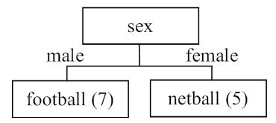
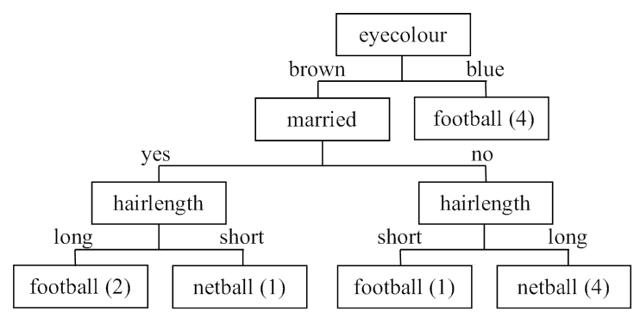
Possible Decision Trees
Which is right and which is wrong?

Slide 14

Entropy
Entropy is an information-theoretic measure of the ‘uncertainty’ contained in a training set, due to the presence of more than one possible classification.
If there are K classes,
we can denote the proportion of instances with classification
i by p_{i} for i = 1 to K.
The value of p_{i} is the number of occurrences of class i divided by the total number of instances,
which is a number between 0 and 1 inclusive.
The entropy of the training set is denoted by E. It is measured in ‘bits’ of information and is defined by the formula, summed over the non-empty classes only, i.e. classes for which p_{i} ≠0.

Slide 15

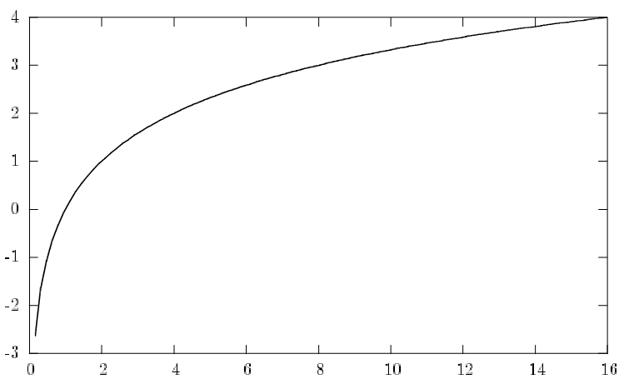
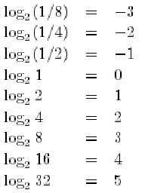
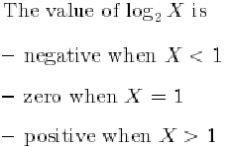
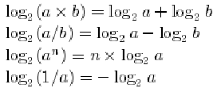

log₂ X
The value of the function is only defined for values of X greater than zero.
The horizontal and vertical axes correspond to values of X and log2 X, respectively
Important Properties

Slide 16
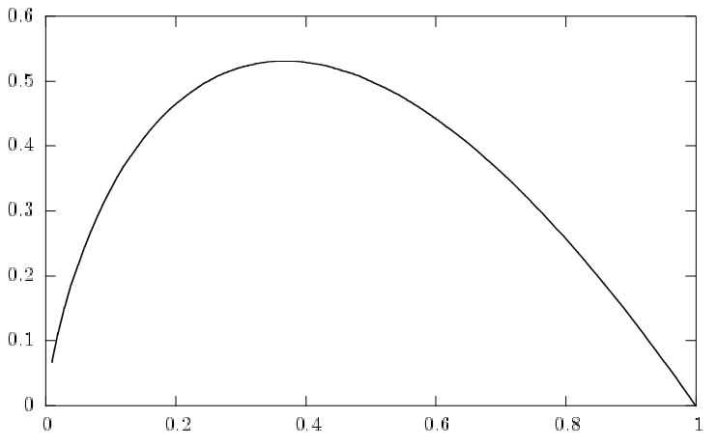
-X log₂ X
The value of this function is also only defined for values of X greater than zero. However the function is only of importance when X is between 0 and 1.
It can be proved that the function −X log₂ X has its maximum value when X = 1/e = 0.3679 (e is the ‘mathematical constant’).
When X takes the value 1/e, the value of the function is approximately 0.5307.
The function can equivalently be written as p log₂(1/p)
-X log₂ X
X

Slide 17
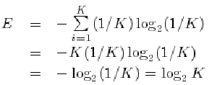
Entropy E
The value of −pi log₂ pi is positive for values of pi greater than zero and less than 1.
When p_{i} = 1 the value of −p_{i} log2 p_{i} is zero.
This implies that E is positive or zero for all training sets.
It takes its minimum value (zero) if and only if all the instances have the same classification, in which case there is only one non-empty class, for which the probability is 1.
Entropy takes its maximum value when the instances are equally distributed amongst the K possible classes.
In this case the value of each p_{i} is 1/K, which is independent of i, so

Slide 18
Lens24 data set
lens24 dataset is ophthalmological data about contact lenses.
24 instances linking the values of four attributes
age (i.e. age group),
specRx (spectacle prescription),
astig (whether astigmatic) and
tears (tear production rate)
with one of three classes 1, 2 and 3 (signifying respectively that the patient should be fitted with hard contact lenses, soft contact lenses or none at all).

Slide 19
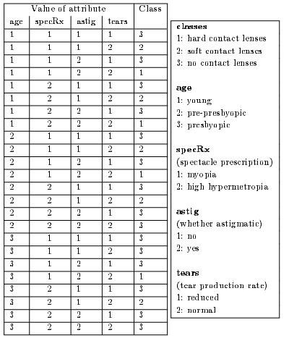
Lens24 data set

Slide 20
Entropy – lens24 Data set
For the initial lens24 training set of 24 instances, there are 3 classes.
There are
4 instances with classification 1,
5 instances with classification 2 and
15 instances with classification 3.
p1 = 4/24, p2 = 5/24 and p3 = 15/24.
We will call the entropy E _{start}
E_{start} = −(4/24) log2(4/24) − (5/24) log2(5/24) − (15/24) log2(15/24)
= 0.4308 + 0.4715 + 0.4238 = 1.3261

Slide 21
Using Entropy for Attribute Selection
The process of decision tree generation by repeatedly splitting on attributes is equivalent to partitioning the initial training set into smaller training sets repeatedly, until the entropy of each of these subsets is zero (i.e. each one has instances drawn from only a single class).
At any stage of this process, splitting on any attribute has the property that the average entropy of the resulting subsets will be less than (or occasionally equal to) that of the previous training set. (Proof sometime later)

Slide 22
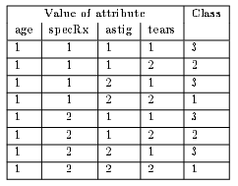
Splitting on age
For the lens24 training set, splitting on attribute age would give three subsets
Training set 1 (age = 1)
Entropy E1 = −(2/8) log2(2/8) − (2/8) log2(2/8) − (4/8) log2(4/8)
= 0.5 + 0.5 + 0.5 = 1.5

Slide 23
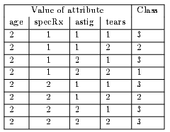
Training set 2 (age = 2)
Entropy E2 = −(1/8) log2(1/8) − (2/8) log2(2/8) − (5/8) log2(5/8)
= 0.375 + 0.5 + 0.4238 = 1.2988

Slide 24
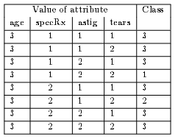
Training Set 3 (age = 3)
Entropy E3 = −(1/8) log2(1/8) − (1/8) log2(1/8) − (6/8) log2(6/8)
= 0.375 + 0.375 + 0.3113 = 1.0613

Slide 25
Using Entropy for Attribute Selection
The entropy of the first of these three training sets (E1) is greater than E_{start}, the weighted average will be less.
The values E1, E2 and E3 need to be weighted by the proportion of the original instances in each of the three subsets.
In this case all the weights are the same, i.e. 8/24.
If the average entropy of the three training sets produced by splitting on attribute age is denoted by E_{new}, then
E_{new} = (8/24)E1+(8/24)E2+(8/24)E3 = 1.2867

Slide 26
Information Gain
If we define Information Gain = E_{start}− E_{new} then
the information gain from splitting on attribute age is
1.3261 − 1.2867 = 0.0394 bits
The ‘entropy method’ of attribute selection is to choose to split on the attribute that gives the greatest reduction in (average) entropy, i.e. the one that maximises the value of Information Gain.
This is equivalent to minimising the value of E_{new} as E_{start} is fixed.

Slide 27
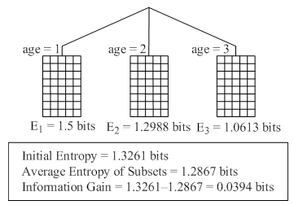

Slide 28
Maximising Information Gain
The values of E_{new} and Information Gain for splitting on each of the four attributes age, specRx, astig and tears are as follows:
attribute age E_{new} = 1.2867
Information Gain = 1.3261 − 1.2867 = 0.0394 bits
attribute specRx E_{new} = 1.2866
Information Gain = 1.3261 − 1.2866 = 0.0395 bits
attribute astig E_{new} = 0.9491
Information Gain = 1.3261 − 0.9491 = 0.3770 bits
attribute tears E_{new} = 0.7773
Information Gain = 1.3261 − 0.7773 = 0.5488 bits
Thus, the largest value of Information Gain (and the smallest value of the new entropy E_{new}) is obtained by splitting on attribute tears
The process of splitting on nodes is repeated for each branch of the evolving decision tree, terminating when the subset at every leaf node has entropy zero.

Slide 29
The smallest number of branches
Dataset excluding entropy entropy most least
lens24 21 9 9
There is no guarantee that using entropy will always lead to a small decision tree, but experience shows that it generally produces trees with fewer branches than other attribute selection criteria

Slide 30

Assignment
Develop a program for TDIDT algorithm and test the algorithm for :-
Take first
Take last
Random 5 times
Entropy
1. Votes
2. Glasses
3. Mushrooms
4. Nursary
5. Lymphography
6. HayesRoth
7. CarsEvaluation
8. Contact Lenses

